Slide 1
CBIR IN MEDICAL IMAGING

Slide 2
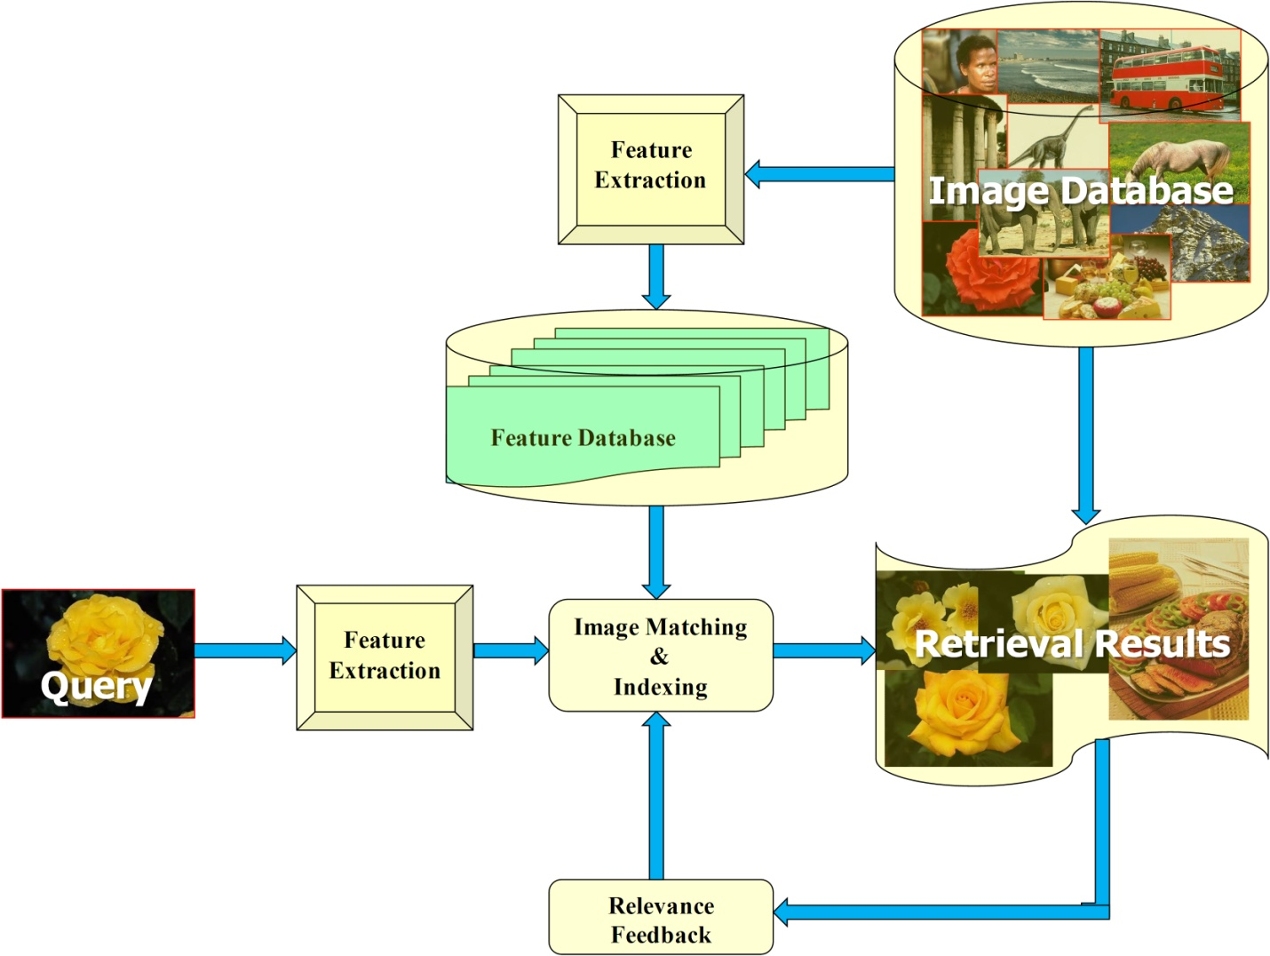
CONTENT BASED IMAGE RETRIEVAL
Fig. : General scheme of content based image retrieval

Slide 3
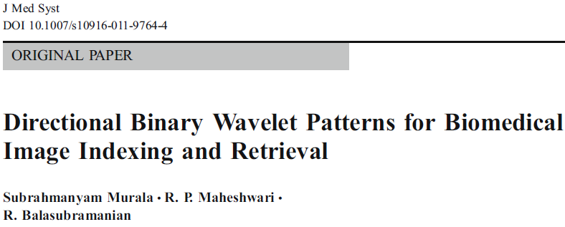
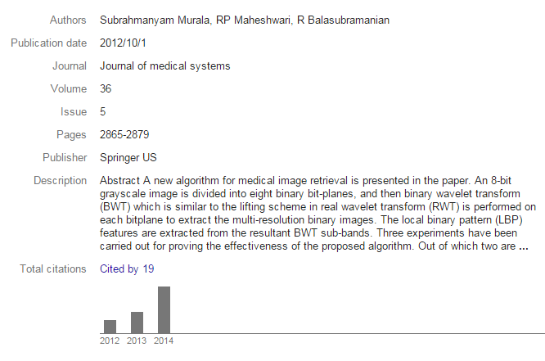

Impact Factor: 1.372

Slide 4
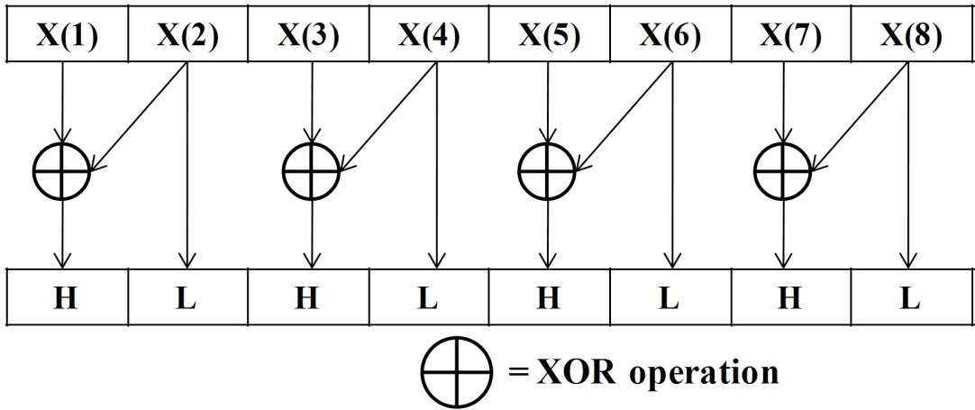
BINARY WAVELET TRANSFORM
Table : Binary wavelet filters grouping of length being equal to 8
Group | Lowpass filter | Highpass filter
1 | {0, 1, 0, 0, 0, 0, 0 ,0} | {1, 1, 0, 0, 0, 0, 0 ,0}
2 | {1, 1, 1, 0, 0, 0, 0 ,0} | {1, 1, 0, 0, 0, 0, 0 ,0}
3 | {1, 1, 1, 1, 0, 0, 0 ,1} | {1, 1, 0, 0, 0, 0, 0 ,0}
4 | {1, 1, 1, 1, 1, 1, 1 ,0} | {1, 1, 0, 0, 0, 0, 0 ,0}
Fig. : In-place implementation of BWT for Group 1 filter

Slide 5
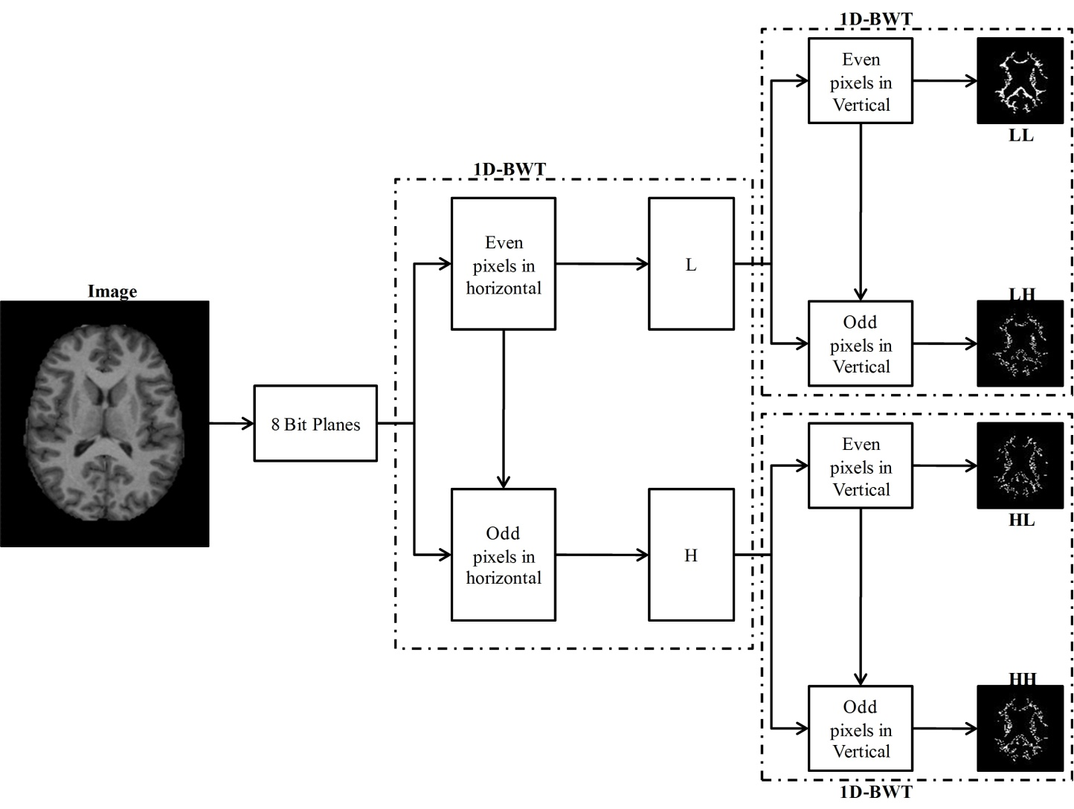
2-D BINARY WAVELET TRANSFORM (2-D BWT)
Fig. : 2D separable BWT implementation

Slide 6
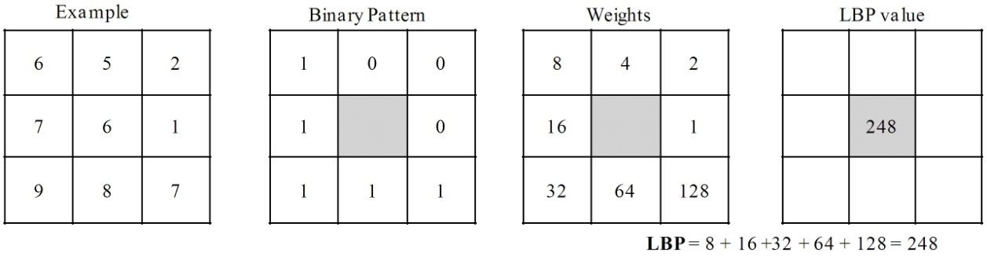
LOCAL BINARY PATTERNS (LBP)
Fig. : Example of obtaining LBP for the 3×3 pattern

Slide 7
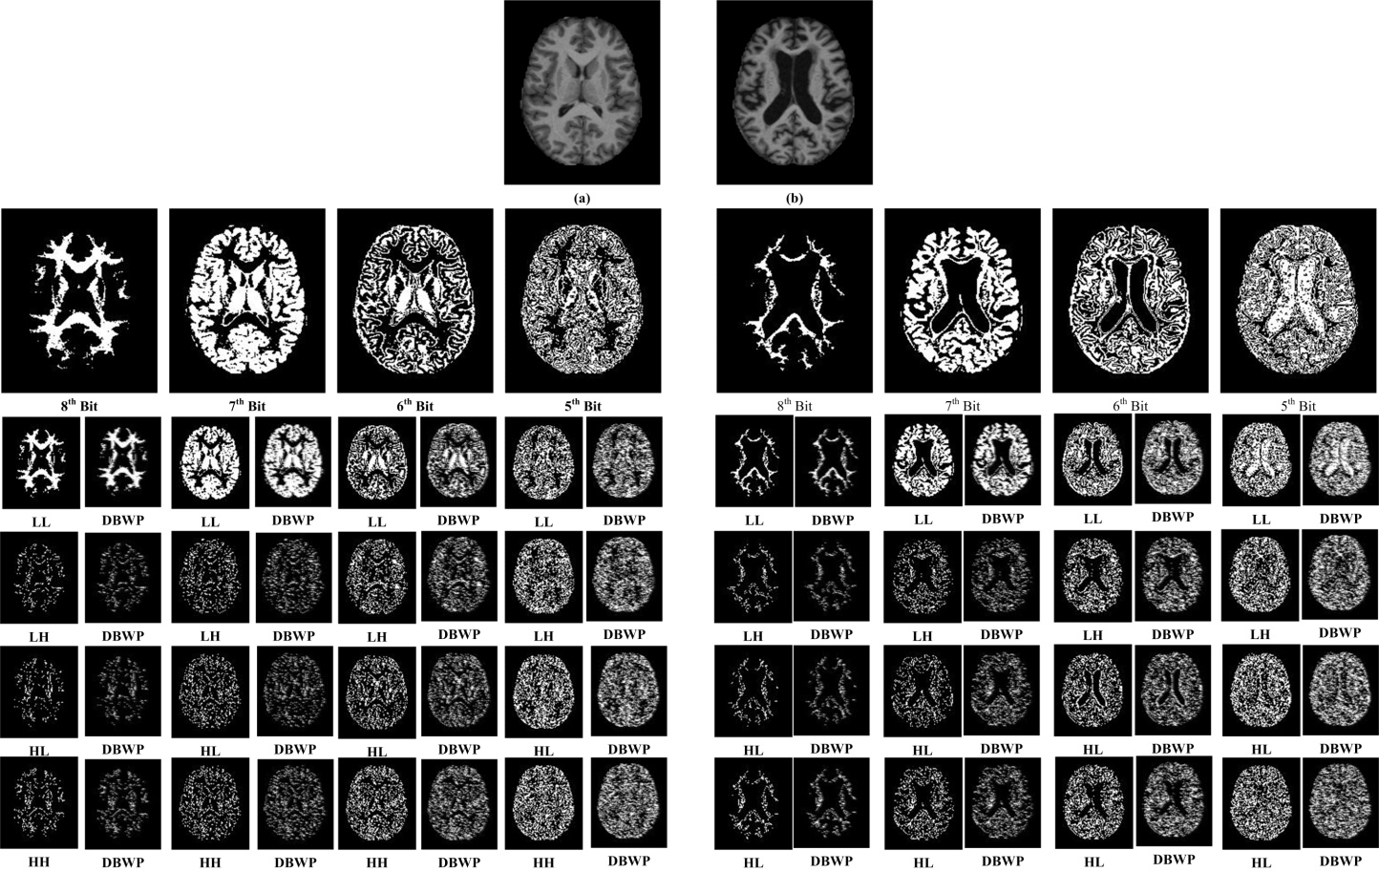
Fig. : Example of obtaining bit planes, BWT sub-bands and DBWP coding for the given two images (a) and (b)

Slide 8
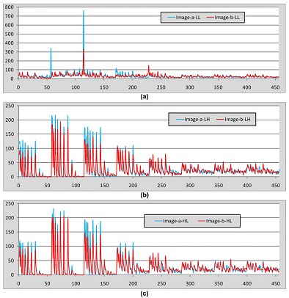
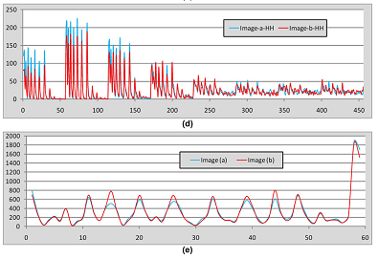
WHY OUR METHOD IS BETTER THAN EXISTING LBP?
Fig. : The features of sample images are calculated and compared each other (a) DBWP of LL sub-band, (b) DBWP of LH sub-band, (c) DBWP of HL sub-band, (d) DBWP of HH sub-band and (e) LBP

Slide 9
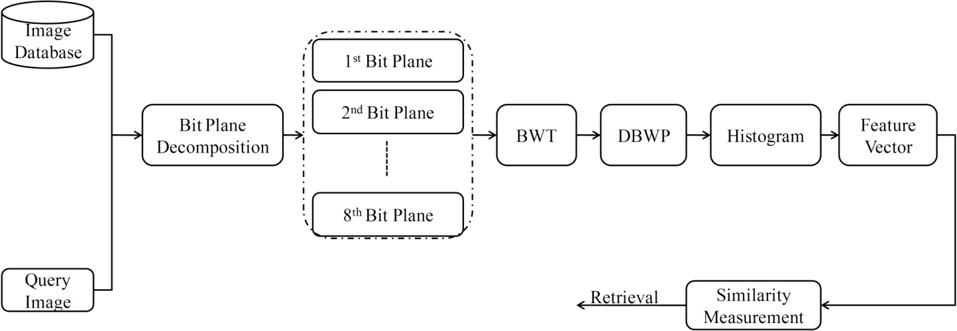
PROPOSED CBRI SYSTEM
Fig. : Proposed retrieval system framework for image retrieval

Slide 10
ALGORITHM
Input: Image; Output: Retrieval result
Load the grayscale image.
Separate the 8-bit planes from the gray image.
Perform the BWT on each bit plane.
Construct the DBWP histograms for all BWT sub-bands.
Construct the feature vector by concatenating all histograms.
Compare the query image with the image in the database.
Retrieve the images based on the best matches.

Slide 11
RESULTS AND DISCUSSIONS
Image Databases
  The Open Access Series of Imaging Studies (OASIS) : MRI dataset
  National Electrical Manufacturers Association (NEMA) : CT scan dataset

Slide 12
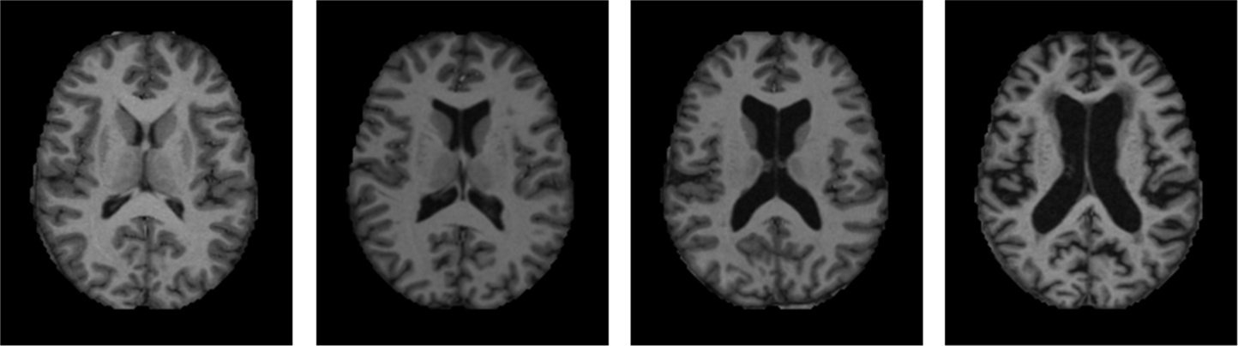
OASIS DATABASE
Fig. : Sample images from OASIS database (one image per category)

Slide 13
Table : MRI data acquisition details
Sequence | MP-RAGE
TR (msec) | 9.7
TE (msec) | 4.0
Flip angle (o) | 10
TI (msec) | 20
TD (msec) | 200
Orientation | Sagittal
Thickness, gap (mm) | 1.25, 0
Resolution (pixels) | 176×208

Slide 14
RESULTS
Table : Results of all techniques in terms of Precision on OASIS Database
 |  | Precision (%) (n=10)
 | Group 1 | Group 2 | Group 3 | Group 4 | Total
LBP_8_1 | 51.77 | 32.54 | 33.82 | 49.06 | 42.63
LBP_16_2 | 52.58 | 38.43 | 31.68 | 51.13 | 44.37
LBP_24_3 | 45.88 | 42.64 | 33.70 | 49.53 | 43.44
GLBP_8_1 | 54.43 | 37.94 | 26.51 | 46.03 | 42.42
GLBP_16_2 | 61.12 | 41.17 | 29.43 | 48.11 | 46.31
GLBP_24_3 | 72.01 | 31.37 | 32.36 | 47.83 | 47.69
DBWP_8_1 | 52.74 | 37.74 | 34.38 | 60.00 | 47.05
DBWP_16_2 | 57.74 | 34.70 | 30.78 | 66.69 | 48.71
DBWP_24_3 | 52.98 | 37.15 | 37.42 | 71.79 | 50.59
n —Number of top matches considered

Slide 15
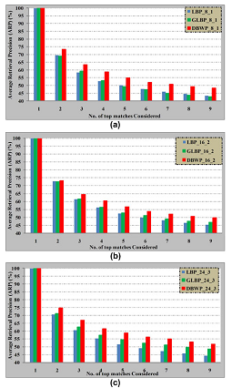
Fig. : Comparison of proposed method (DBWP) with the other existing methods as a function of number of top matches considered on OASIS database

Slide 16
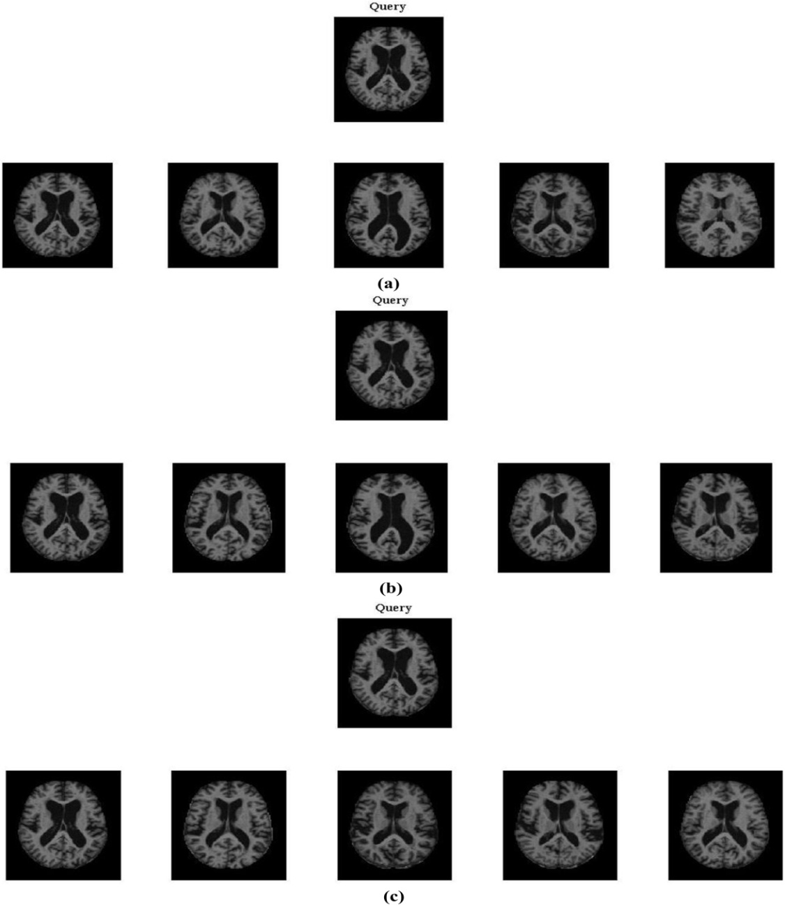
Fig. : Retrieval results of proposed method: (a) DBWP_8_1, (b) DBWP_16_2 and (c) DBWP_24_3.

Slide 17
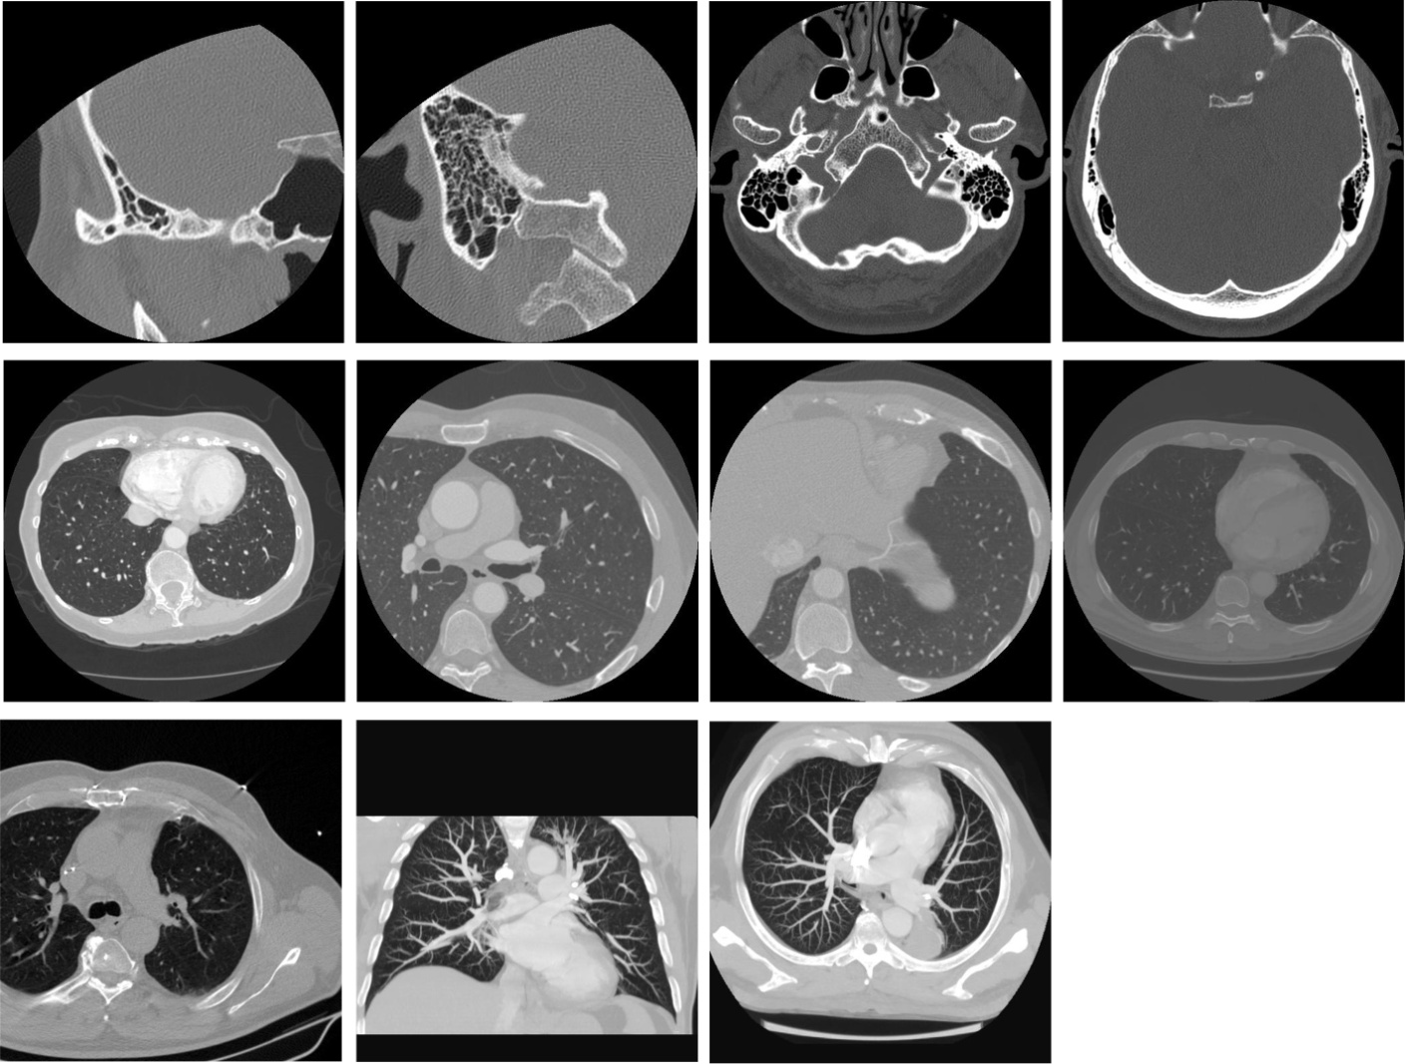
NEMA DATABASE
Fig. : Sample images from NEMA database (one image per category)

Slide 18
Table : Data acquisition details of NEMA–CT image database
class No. | Data | No. of slices | Resolution | In-plane resolution | Slice thickness | Tube voltage (kV) | Tube current (mA)
1 | CT0057 | 104 | 512×512 | 0.187500 | 1.00 | 130 | 30
2 | CT0060 | 75 | 512×512 | 0.312500 | 0.50 | 130 | 30
3 | CT0082 | 59 | 512×512 | 0.742188 | 5.00 | 130 | 30
4 | CT0080 | 253 | 512×512 | 0.820312 | 1.25 | 130 | 30
5 | CT0001 | 54 | 512×512 | 0.597656 | 3.00 | 130 | 30
6 | CT0003 | 364 | 512×512 | 0.625000 | 0.625 | 130 | 30
7 | CT0020 | 555 | 512×512 | 0.488281 | 0.625 | 130 | 30
8 | CT0083 | 69 | 512×512 | 0.703125 | 15.80 | 130 | 30

Slide 19
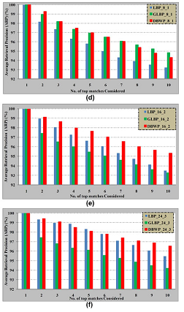
RESULTS
Fig. : Comparison of proposed method (DBWP) with the other existing methods as a function of number of top matches considered on NEMA–CT database

Slide 20
CONCLUSIONS
A novel method employing DBWP operator is proposed for texture based biomedical image retrieval.
DBWP extracts the information from images using edges which are calculated by applying BWT on each bitplane of grayscale image.
Further, the features are extracted by performing LBP operation on each sub-band of BWT.
The effectiveness of the proposed method is tested by conducting two set of experiments for medical image retrieval thereby, significantly improving the performance in terms of their respective evaluation measures.

Slide 21
Thank You

